Slide 1
Chapter 7

Slide 2
Objectives

Slide 3
Objectives (cont.)

Slide 4
The validation controls provided by ASP.NET

Slide 5
Typical code for processing a page that contains validation controls

Slide 6
Common validator properties

Slide 7
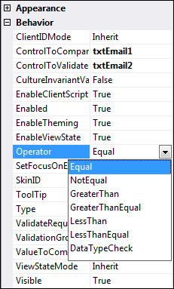
The Behavior category in the Properties window for a Compare validator

Slide 8
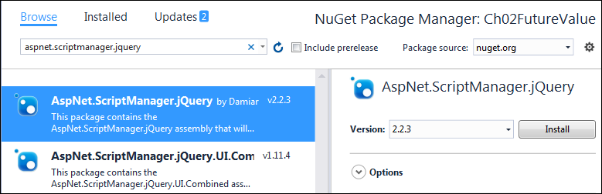
The NuGet Package Manager page

Slide 9
How to install the NuGet package for jQuery validation

Slide 10
A validator that checks for a required entry

Slide 11
A property of the required field validator

Slide 12
A required field validator that forces an option to be chosen from a list box

Slide 13
Properties of the compare validator

Slide 14
A compare validator that checks for an integer value

Slide 15
A compare validator that compares the values of two text boxes

Slide 16
Properties of the range validator

Slide 17
A range validator that checks a date range that’s set at runtime

Slide 18
Code that sets the min and max values at runtime

Slide 19
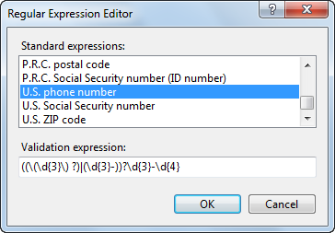
The Regular Expression Editor dialog box

Slide 20
A property of the regular expression validator

Slide 21
A regular expression validator that validates U.S. phone numbers

Slide 22
Common regular expression elements

Slide 23
Examples of regular expressions

Slide 24
The aspx code for a text box and a custom validator

Slide 25
Properties of the ServerValidateEventArgs class

Slide 26
C# code for the custom validation

Slide 27
Properties of the validation summary control

Slide 28
The aspx code for a validation summary control and two validators

Slide 29
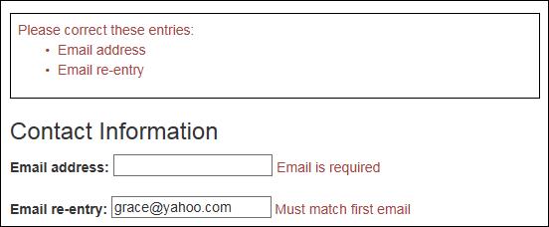
How the error messages appear on the web page

Slide 30
The property for working with validation groups

Slide 31
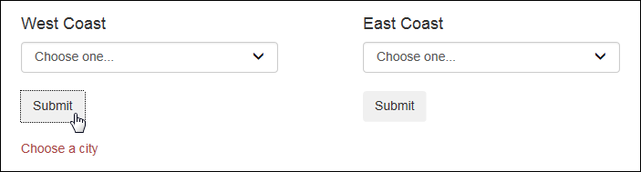
Part of a web form that accepts a city from the east or west coast

Slide 32
A drop-down list with a validator that specifies a validation group

Slide 33
A drop-down list with a validator that specifies a validation group (cont.)

Slide 34
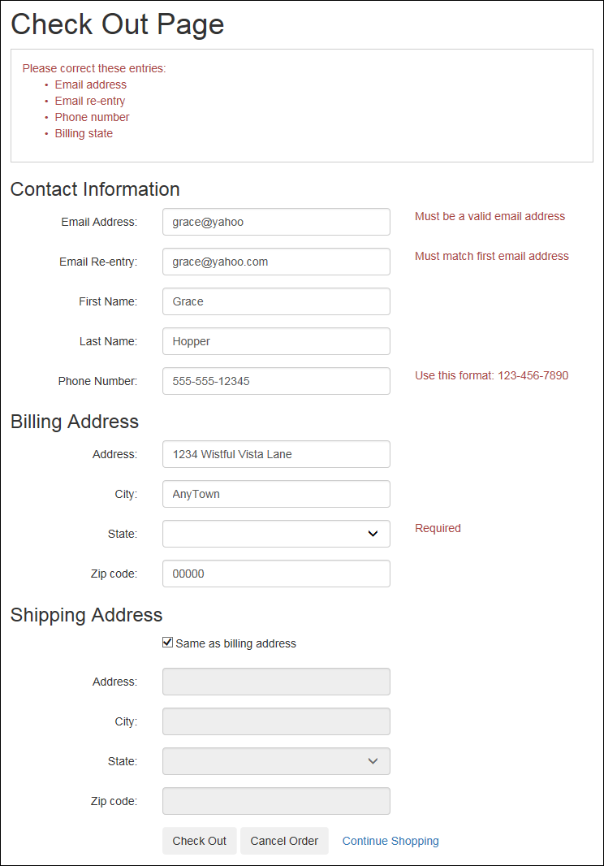
The Check Out page with validation

Slide 35
The start of the aspx code for the CheckOut page

Slide 36
The start of the aspx code for the page (cont.)

Slide 37
The start of the aspx code for the page (cont.)

Slide 38
The start of the aspx code for the shipping address

Slide 39
The start of the aspx code for the shipping address (cont.)

Slide 40
Some of the C# code in the code-behind file

Slide 41
Some of the code in the code-behind file (cont.)

Slide 42
Some of the code in the code-behind file (cont.)

Slide 43
Some of the code in the code-behind file (cont.)

Slide 44
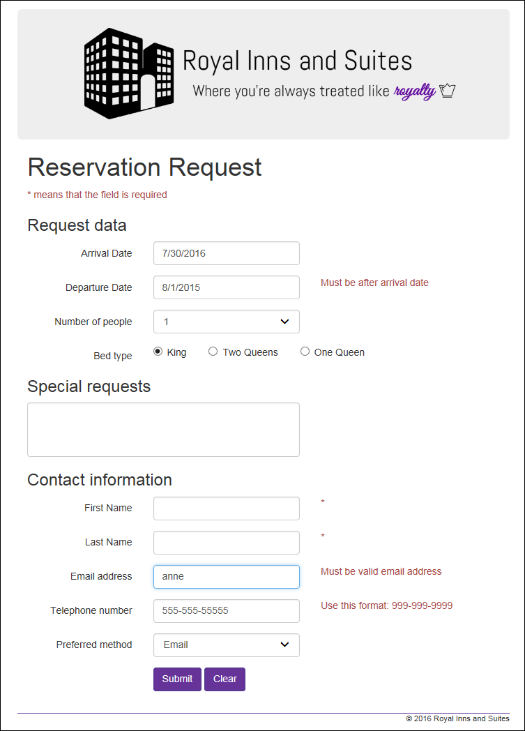
Extra 7-1 Add validation to the Reservation form

